Slide 1
Social Media Toolkit

Slide 2
Social media handles and hashtags
Please tag us on all posts. Our social media handles are:
@dasra
@dasraindia
/dasraindia
/dasra
Hashtags you can use:
#AbMeriBaari
#RightToSafety
#RightToHealth
#RightToEducation
#RightToChoice

Slide 3
Guidelines
LANGUAGE:
Please primarily speak to the four 10to19 Community outcomes where possible, which are:
Increasing agency
Completion of secondary education
Delaying age at marriage
Delaying age at first pregnancy
When talking about girl empowerment use language around “working on adolescent health and well-being”
Always call what the girls ask for as ‘recommendations’ and not ‘demands’ or ‘solutions’
While talking about the charter, please understand that the recommendations are not evidence-based or proven by statistics, rather they are subjective based on audits conducted in 63 villages by trained Girl Champions
Try to avoid as much as possible, the word ‘movement’ or ‘campaign’ and call it an ‘initiative’. The other two are often associated with activism. Also avoid phrases like ‘lobbying the government’.
BRANDING:
Please don’t add any logos on the creatives – use the Ab Meri Baari frames to post photos / testimonials from your adolescents.

Slide 4
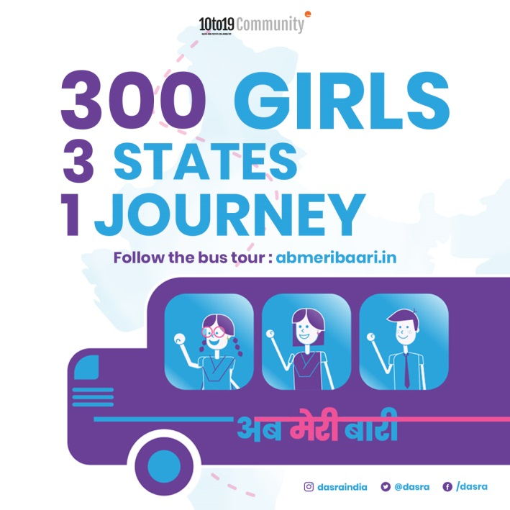
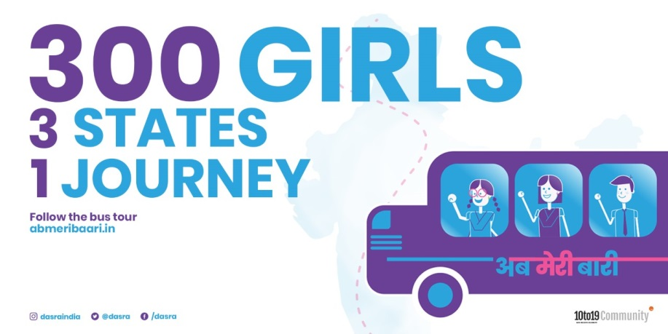
Social Media Posts
Post Text: “#Adolescent Rights are important. We are with the 10to19 Community in its journey to amplify voices of India’s adolescents and bring attention to their issues. @dasra (@dasraindia on Instagram) #AbMeriBaari”

Slide 5
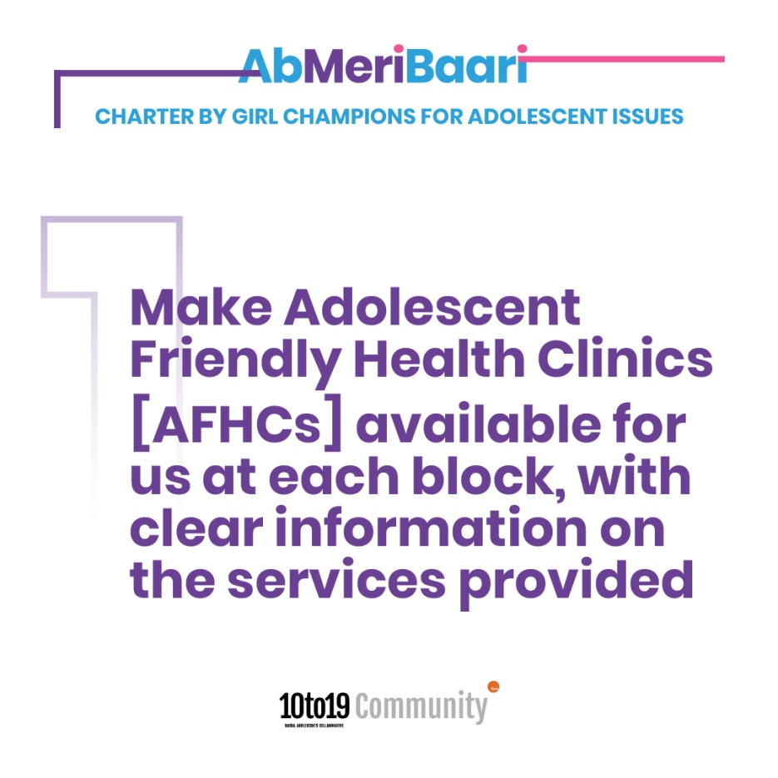
Charter of Recomendations
Recommendation 1:
“The #socialaudit showed that 28 out of 63 villages in #Jharkhand had AFHCs that didn’t open regularly. #AbMeriBaari Girl Champions want them to open for all 5 days instead of just 2 or 3 for regular access to health services.”

Slide 6
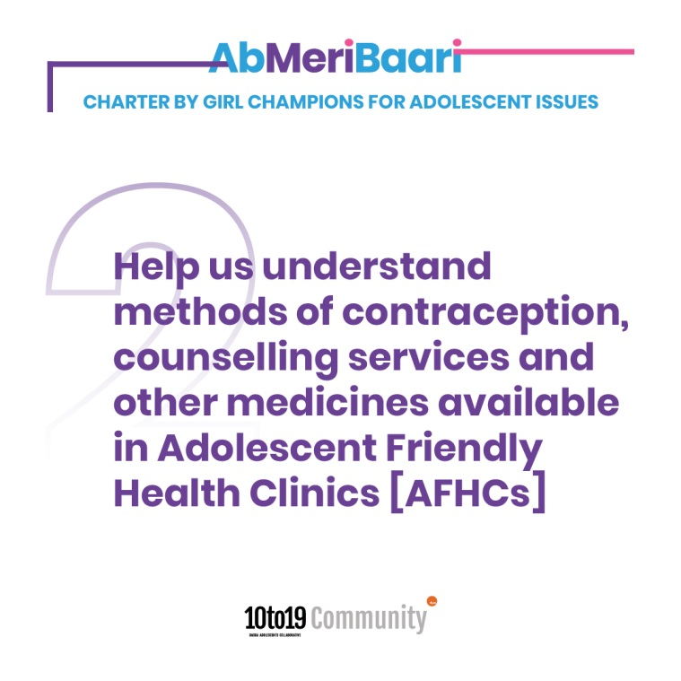
Recommendation 2
Post text: “#AbMeriBaari social audits indicated that services around sexual and reproductive health is not available in 14 out of 63 villages in Jharkhand. Girl champions want regular services and female medical officers”

Slide 7
Recommendation 3
Post text: “18 out of 63 villages in Jharkhand did not display information on non communicable and communicable diseases. #AbMeriBaari girl champions recommend trained ANMs in CHCs #SocialAudit”

Slide 8
Recommendation 4
Post Text: “Our schools need more teachers as 20 out of 63 villages did not have sufficient number of teachers during #AbMeriBaari social audit in Jharkhand”

Slide 9
Recommendation 5
Post Text: “Free books are essential to improve education but #AbMeriBaari social audit found that 11 out of 63 villages did not have free books “

Slide 10
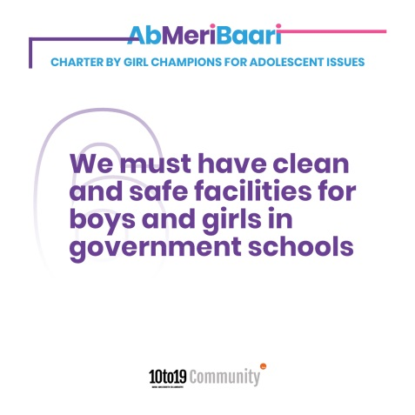
Recommendation 6
Post Text: “#AbMeriBaari social audit found that separate and clean toilets are not available in govt schools in 15 out of 63 villages in Jharkhand. We must have regular cleaning and maintenance of toilets in school”

Slide 11
Recommendation 7
Post Text: “#AbMeriBaari social audit found that #sanitarypads are not available in 50 out of 63 villages in #Jharkhand. #GirlChampions recommend that pads should be available in aanganwadis for better access”

Slide 12
Recommendation 8
Post Text: “10 out of 63 villages in Jharkhand did not display information on child marriage and only 3 villages run regular campaigns to combat #childmarriage. #AbMeriBaari #socialaudit”

Slide 13
Recommendation 9
Post Text: “#GirlChampions demand greater role in #childprotection by making them aware of #POCSO and JJ Act in #AbMeriBaari #socialaudit”

Slide 14
Recommendation 10
Post Text – “34 out of 63 villages don’t have a functioning VLCPCs. Including the #voices of #adolescents in forming these VLCPCs can better their #safety. #AbMeriBaari #GirlChampions”

Slide 15
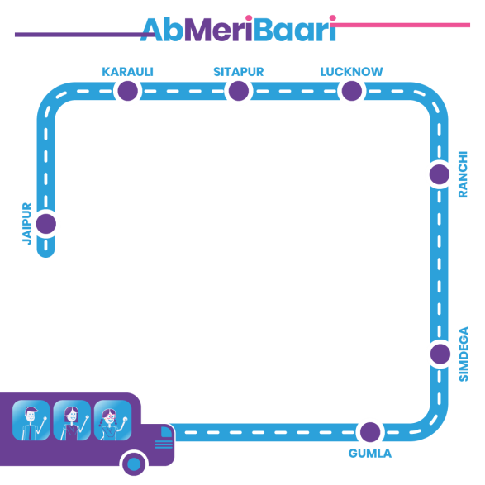
Social Media Frames
Use these to post testimonials, stories and experiences on health, safety, nutrition and education to support the Charter by the Ab Meri Baari Girl Champions.

Slide 16
THANK YOU!

